Slide 1
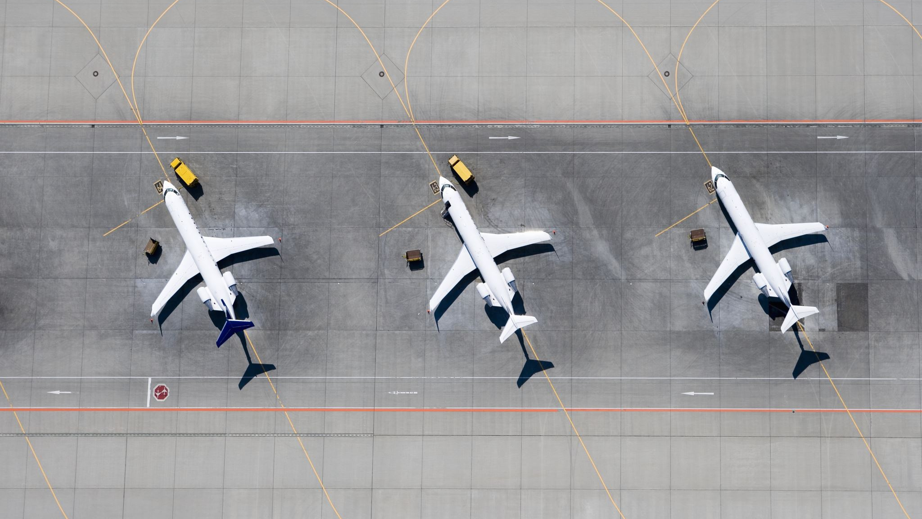
Air Traffic Incidents 2000-2022
Ben MacDonald
Notes:
Good afternoon, my name is Ben MacDonald and I will be presenting my analysis on Air Traffic Accidents from 2000 to 2022

Slide 2

Intro
Dataset:
Individual aircraft incidents and associated factors
Data Types:
Categorical (required significant cleaning to be useable)
Exclusions:
Ground casualty figures (most were purely coincidental)
Flight Types:
Passenger, cargo, private, military

Slide 3
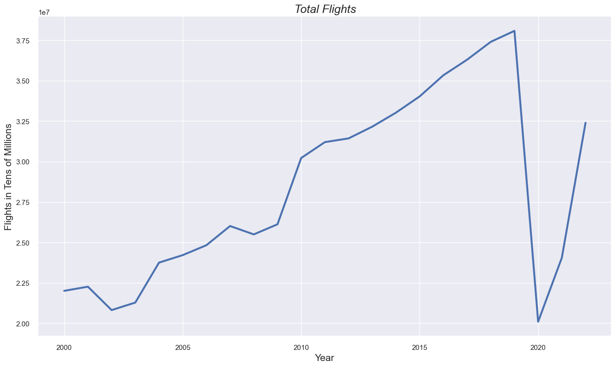
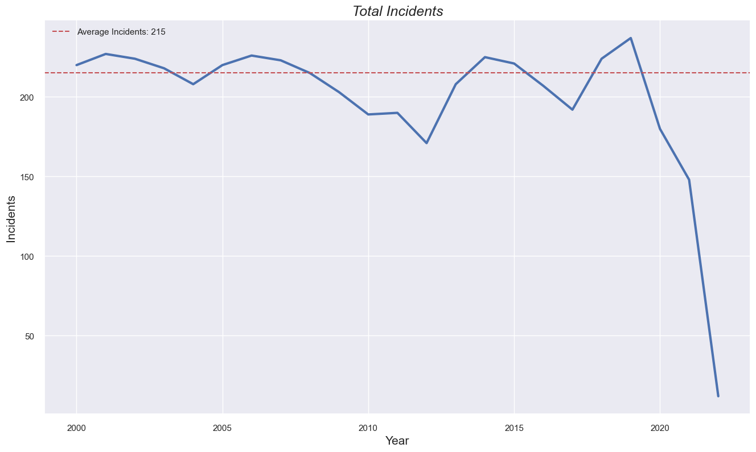
Air Traffic Incidents by the numbers
Covid-19
Covid-19

Slide 4
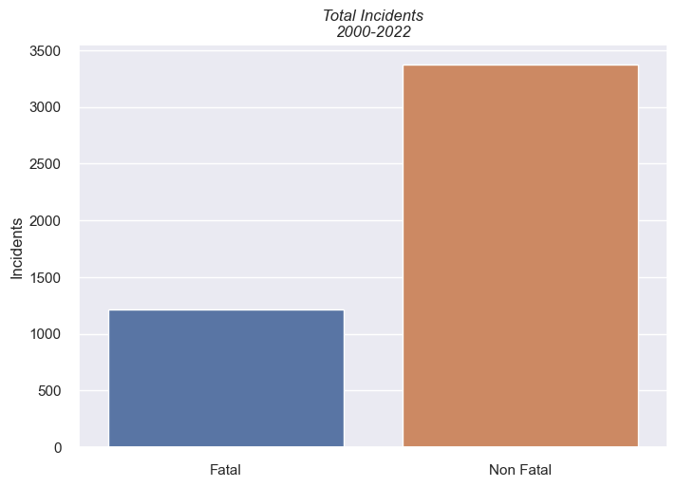
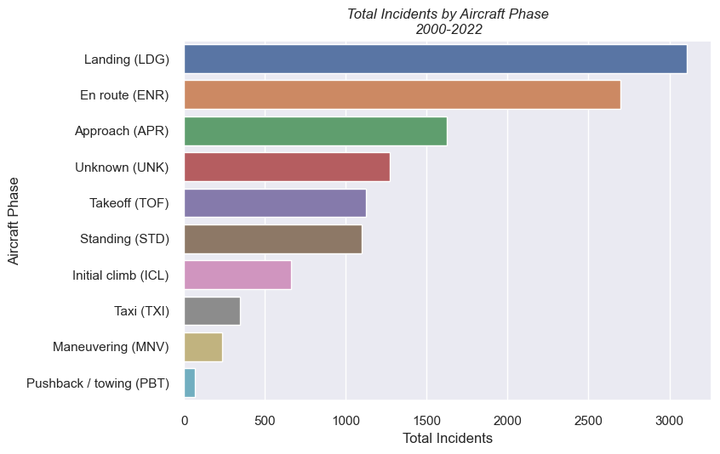
Air Traffic Incidents by the numbers
73.6% of incidents were not fatal
26.4% were fatal
Most incidents occur during flight and landing phases

Slide 5
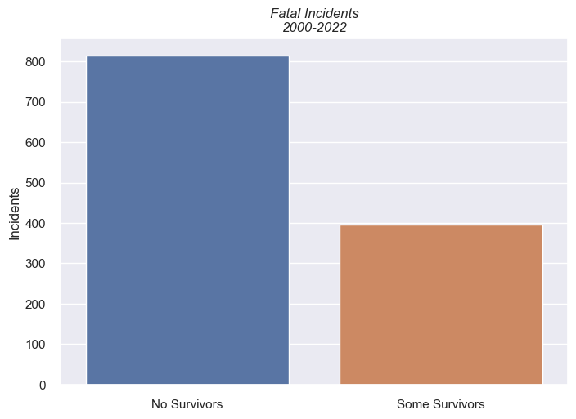
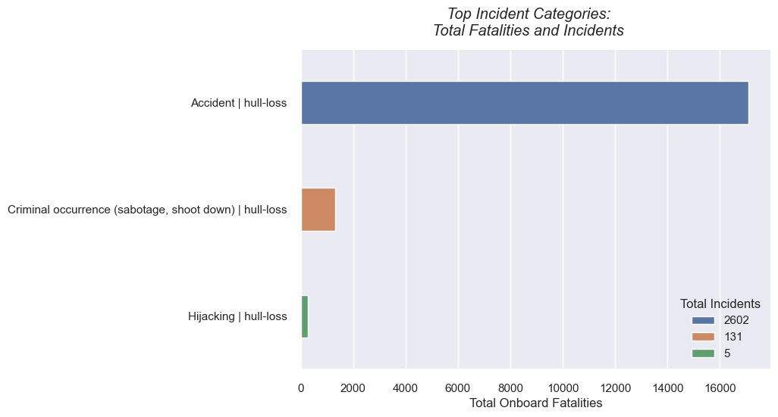
Air Traffic Incidents by the numbers
67% of fatal incidents had no survivors
33% had some
Most incidents were categorized as accidental

Slide 6
Hypotheses
Null:
Incident causes have no influence on fatal occurrences
Alternate:
Incident causes have a significant influence on fatal occurrences
Notes:
I chose to use Individual incident causes as my feature variables and a binary value indicating whether the incident was fatal as my target variable for model training and hypothesis testing.

Slide 7
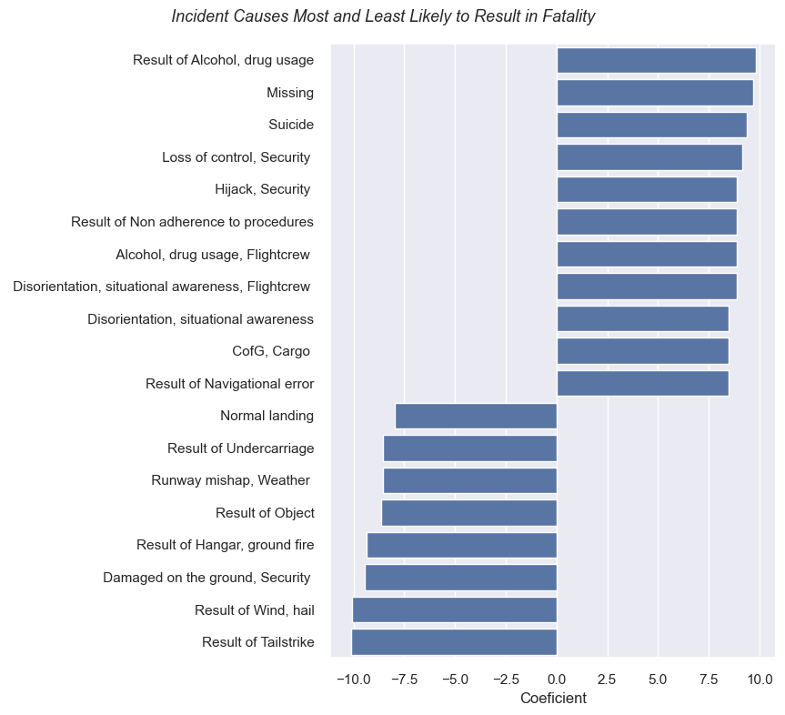

Hypotheses revisited
Most Likely
Null:
Incident causes have no influence on fatal occurrences
Alternate:
Incident causes have a significant influence on fatal occurrences
x
Least Likely
Notes:
I used the Chi squared test to test my hypothesis and found that the p-value was significantly smaller than my 5% threshold. This led me to reject the null hypothesis and accept my alternate hypothesis. I then trained a logistic regression model using my feature and target variables and found a strong predictive relationship between individual incident causes and fatal or non-fatal incidents. On the graph to the right you can see the causes with the strongest positive and negative coefficients from my model. On the top are the causes that had a positive coefficient and show a strong relationship with fatal incidents. And on the bottom of the graph you can see causes with the lowest coefficients which indicate a strong relationship with non-fatal incidents.

Slide 8

Key Findings
Air travel is very safe
Most accidents do not result in fatalities
When there are fatalities, there tends to be a total loss of occupants
Incident causes are a statistically strong predictor of whether an incident will result in fatalities or not

Slide 9

Information
GitHub Repository:
https://github.com/b-macd/Air_Travel_Safety_Analysis
Datasets:
https://www.kaggle.com/datasets/deepcontractor/aircraft-accidents-failures-hijacks-dataset
https://data.worldbank.org/indicator/IS.AIR.DPRT
Contact:
benjamin.t.macdonald.mil@army.mil

Slide 10
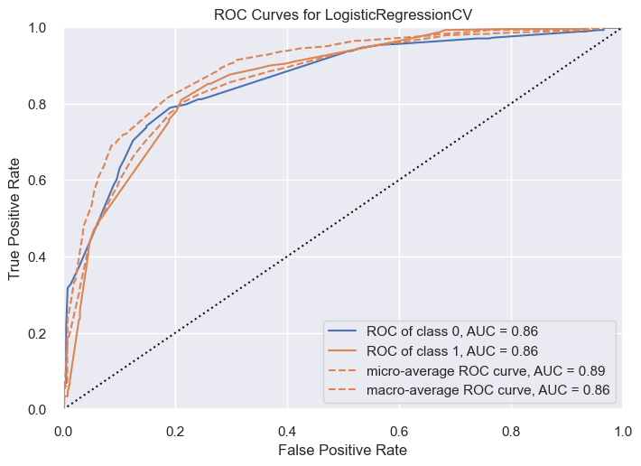
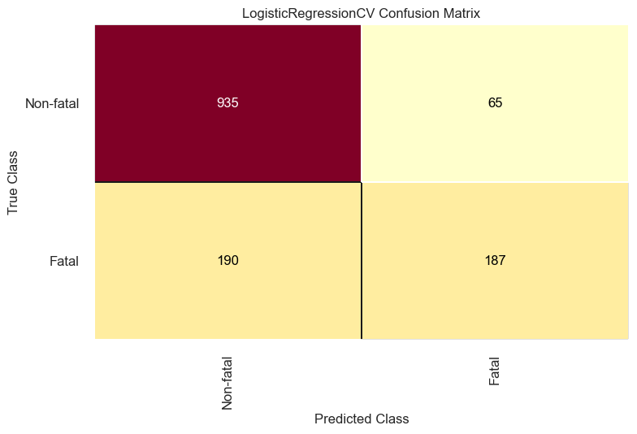
Appendix

Slide 11
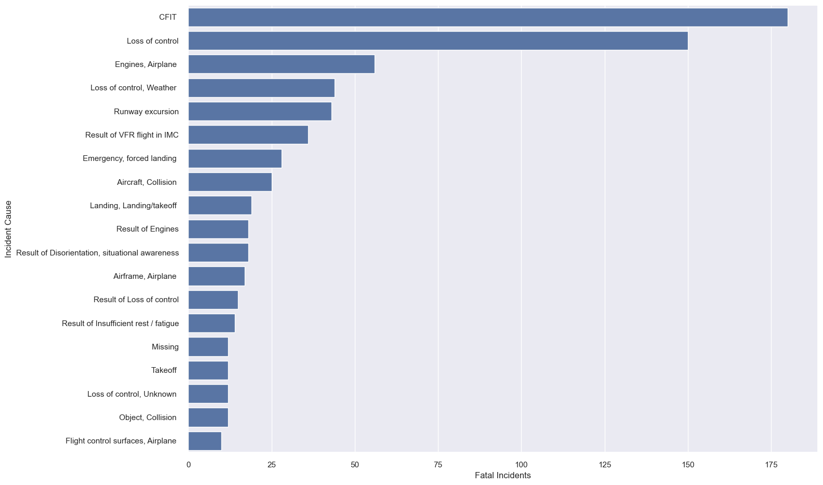
Appendix

